Slide 1


Bridging Bitcoin and
the Energy Transition
SBP: Tokenized Proof of Clean Energy use in Bitcoin mining
Institutional Access to Climate-Aligned Bitcoin Exposure

Slide 2




Bitcoin is the World’s Most Scalable Clean Energy Buyer
So why hasn’t climate-aligned capital flowed into Bitcoin, the fastest appreciating asset of the past decade?
There is no verifiable data layer to validate that Bitcoin’s energy demand is driving gigawatts of renewables.
Meanwhile $35 Trillion of Institutional Capital is mandated to invest in climate aligned investments.
💡 What if Bitcoin’s clean energy footprint could be verified and invested in?

Slide 3
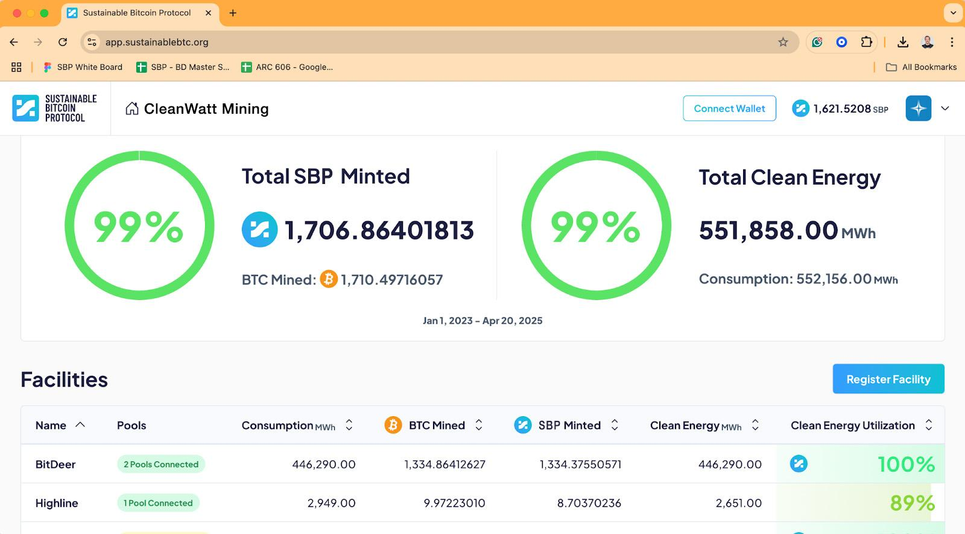
Infrastructure Powering
Verifiable Clean Energy Mining
Live platform with the leading Public, Sovereign & Private miners globally
Institutional‑grade sustainability layer
Largest aggregator & repository of Bitcoin Mining Energy data
18,000+ BTC verified, backed by more than 7 Million MWh of clean energy data
✅Onchain proof that BTC was mined with verifiable clean energy.

Slide 4
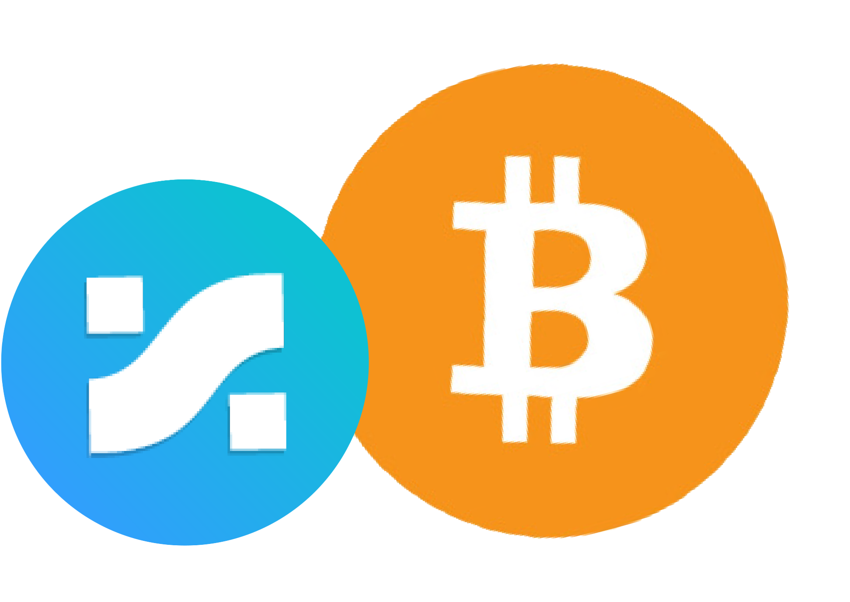
SBP Token:
Energy Transition Asset for Bitcoin
A Regulated Digital Asset that Pairs Bitcoin with Verified Clean Energy
SBP Token = Proof of Clean Energy Use: Each token corresponds to verified, audited renewable energy used in Bitcoin mining.
Built for Institutional Portfolios: Traceable, auditable, and designed for Bitcoin to meet sustainability mandates.
Earned, Not Minted: Only created when miners validate clean energy usage—no speculation, no double counting.
SBP+BTC:
Clean Energy Backed
Digital Store of Value
The first and only way to invest in climate-aligned Bitcoin

Slide 5

Built for Institutions
Powered by
Clean Miners
23% of Global hashrate - Public, Sovereign & Private miners
⚡️ Clean mining now earns more.

Slide 6
A Developing Ecosystem for Bitcoin‑Energy Transition Finance
Building New Institutional Investment Products:
Clean‑Wrapped BTC Tokenized proof‑of‑clean‑work BTC, ready for issuance by Zodia Custody, Coinbase and top custodians
Energy‑Transition Bitcoin ETFs Spot BTC + SBP ETFs in development with leading European and U.S. issuers
Structured Bitcoin Climate Finance Bitcoin collateralized lending and real world solar yield products built on verifiable clean‑work
🥇 The first digitally native investment, purpose built for the energy transition

Slide 7


Join us to:
Ignite Bitcoin’s Potential to Finance The Energy Revolution
Welcome the first $1 Trillion of
Climate Aligned Capital to Bitcoin
www.sustainablebtc.org

